Slide 1
Project Name Star Organic Farm
Presentation by
Syed Shahryar Haider Rizvi

Slide 2
Faculty: Miss arooba TAJWAR Batch Coordinator: Miss faiza batch code: 2103B1
Project Name:
Star Organic Farm

Slide 3
Team mate names
Syed Shahryar Haider Rizvi
Student 1307816
Gulfam Gujjar
Student 1307814
Project Name:
Star Organic Farm

Slide 4
Index
Home Page
Product Page (44 products)
Each Product Detail pages (44 products)
Contact us page
Gallery page
Query page
Project Name:
Star Organic Farm

Slide 5
Star Organic farm is commenced in the year 1988. Company is involved in trading and manufacturing a wide range of Organic Products and spices to the consumers all around the global market. Company has wide variety of collection of products lies of Nutritious cereals, Pulses, Spices and Condiments, Cooking Oils, Fruit Pulps, Agro Products, Oils, Wheat and Wheat Flour, Rice and Rice products and so on.
Project Name:
Star Organic Farm

Slide 6

This is our logo
Project Name:
Star Organic Farm

Slide 7
Website name is “STAR ORGANIC FARM” and the theme used for the website is purple and white color to make it look attractive.All pages consists of header, body and footer.
Header has logo and a sticky Nav bar in which JavaScript coding is used and also bootstrap is used .
Home body of website has four sections. In first section, used images of different condiments and second section has information about quality, taste and responsibility with images which html css and bootstraps fluid-container is used for making sections and shadow transition property is use to make it look 3D. In third section used carousel with different types of product images like condiments spices rice nutrition cereals etc. and fourth section has information about our recipes using images html and css properties.
Footer comprises of website links, office information, sign up section and copyright. In which bootstrap and css is used
Project Name:
Star Organic Farm

Slide 8
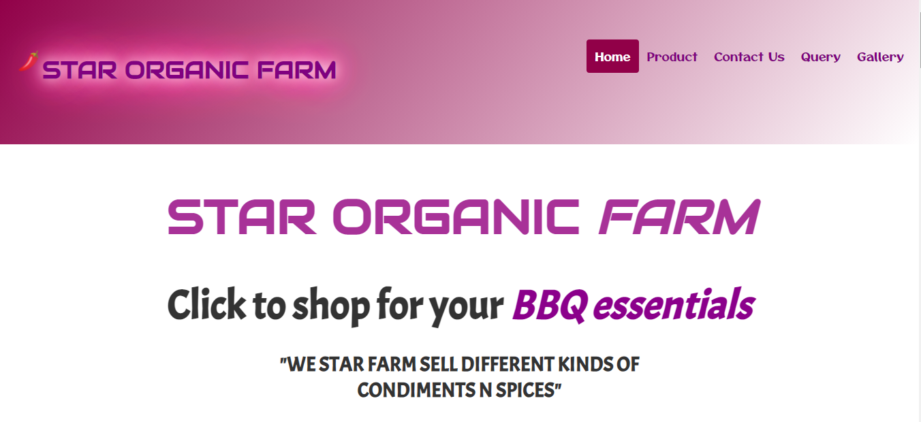
Snap shot of our Home page:
Project Name:
Star Organic Farm

Slide 9

Snap shot of our Home page:
Project Name:
Star Organic Farm

Slide 10
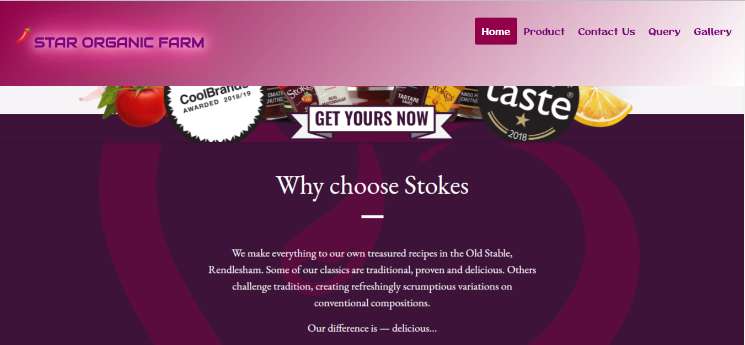
Snap shot of our Home page:
Project Name:
Star Organic Farm

Slide 11
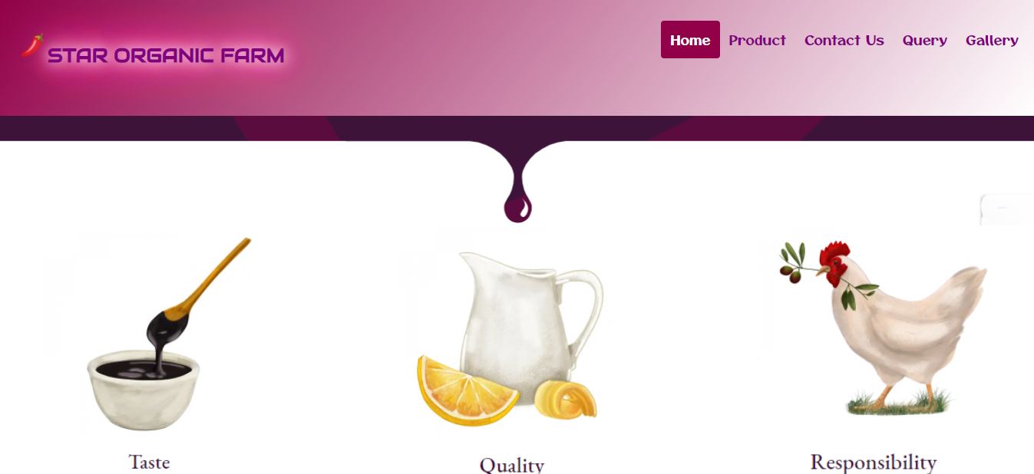
Snap shot of our Home page:
Project Name:
Star Organic Farm

Slide 12
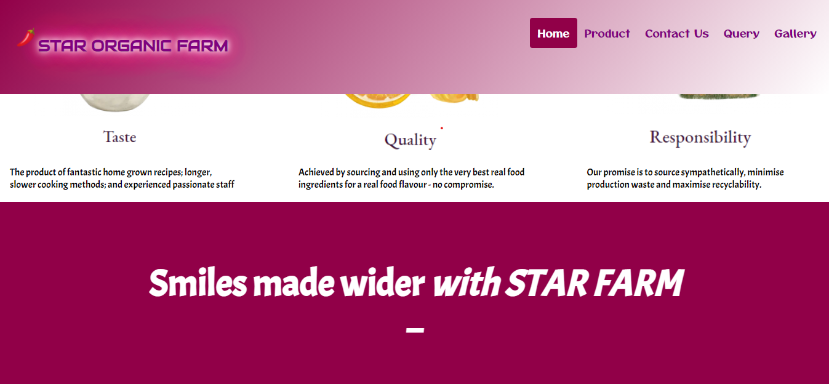
Snap shot of our Home page:
Project Name:
Star Organic Farm

Slide 13
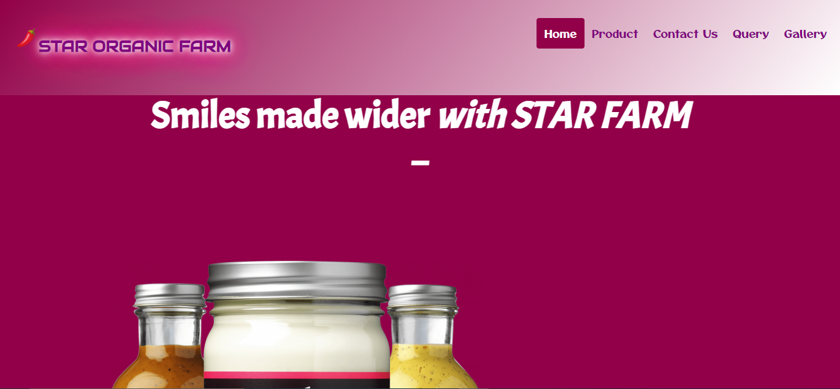
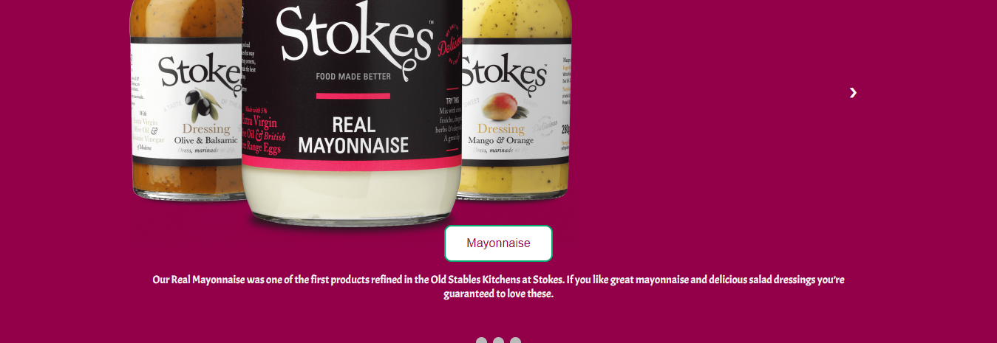
Snap shot of our Home page:
Project Name:
Star Organic Farm

Slide 14
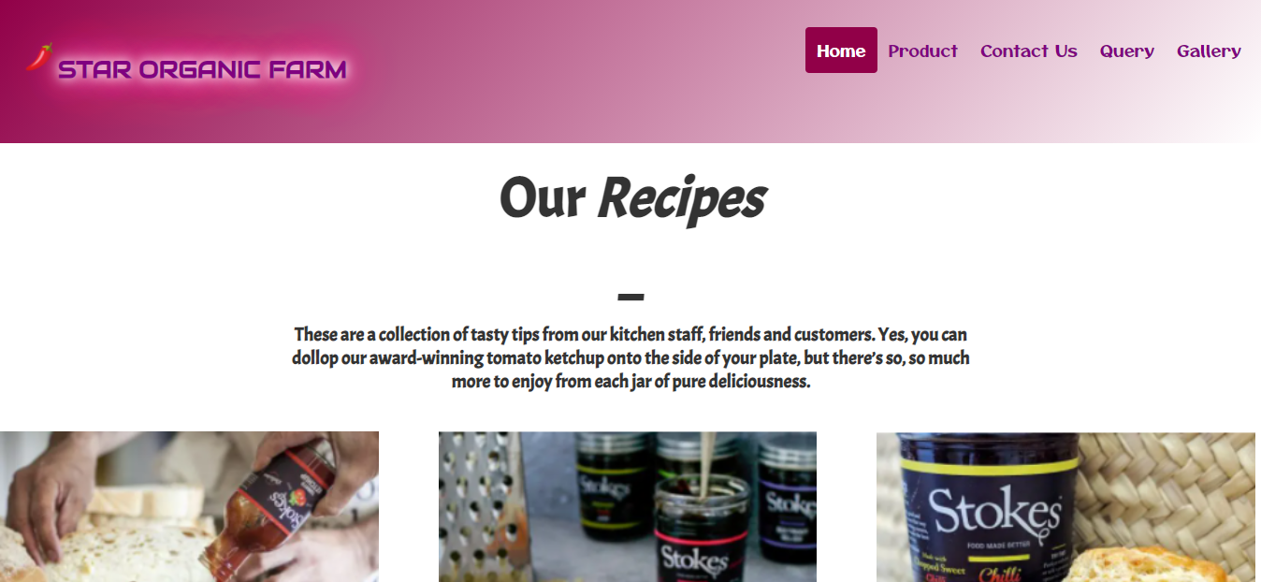

Snap shot of our Home page:
Project Name:
Star Organic Farm

Slide 15
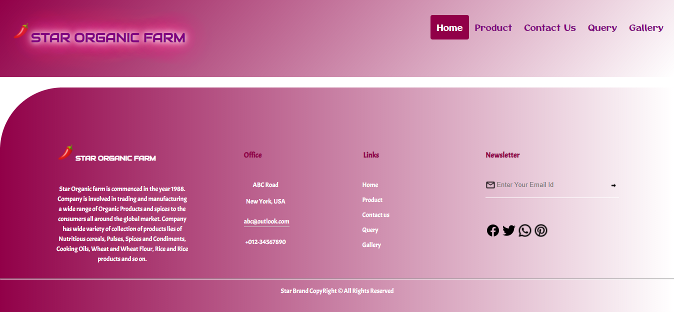
Snap shot of our footer:
Project Name:
Star Organic Farm

Slide 16
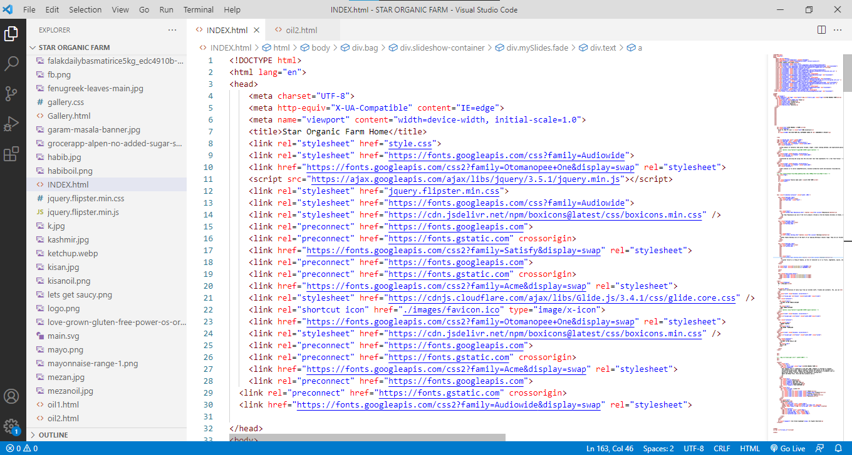
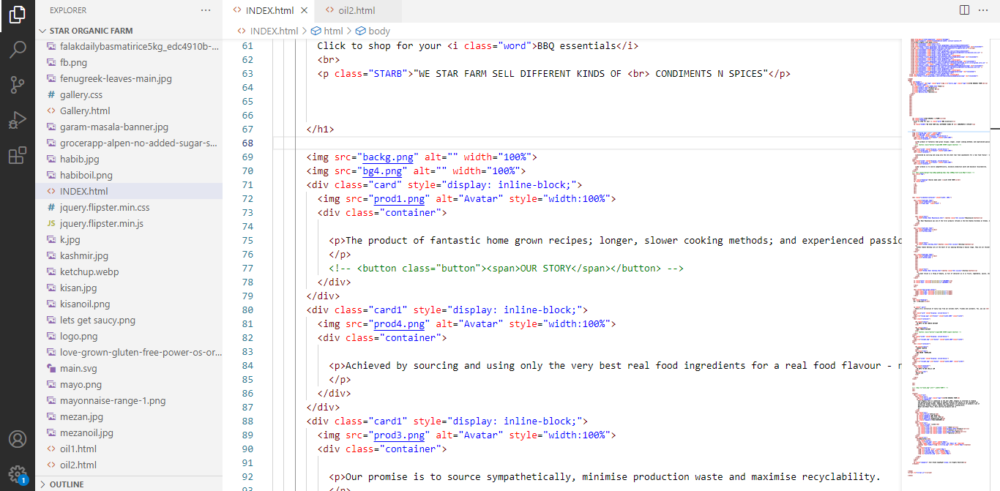
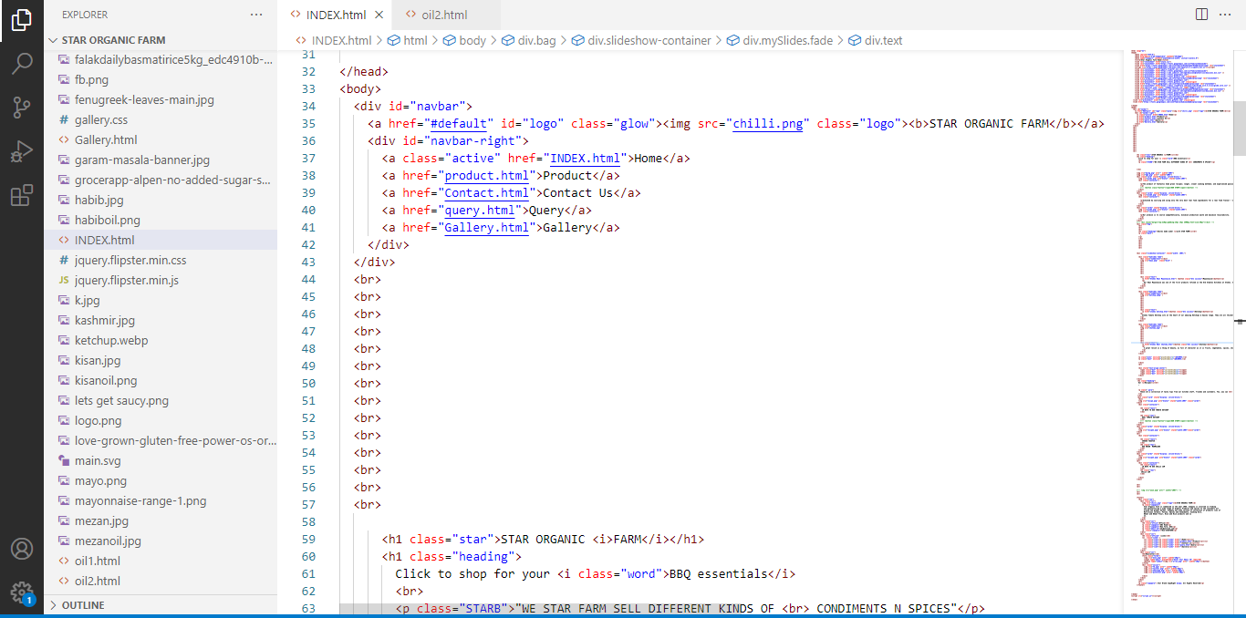
Some snap shots of Home page code:
Project Name:
Star Organic Farm

Slide 17
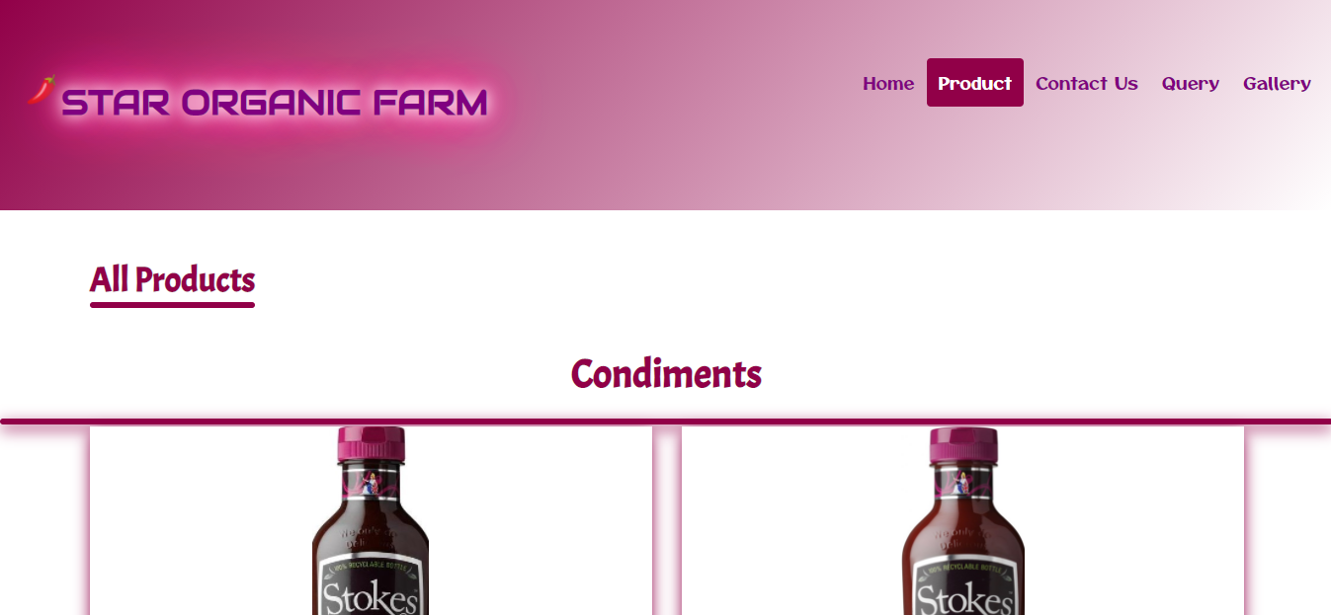
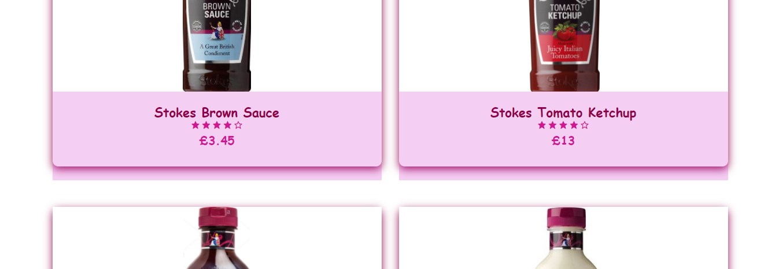
Some Snap shot of our Product page:
Project Name:
Star Organic Farm

Slide 18
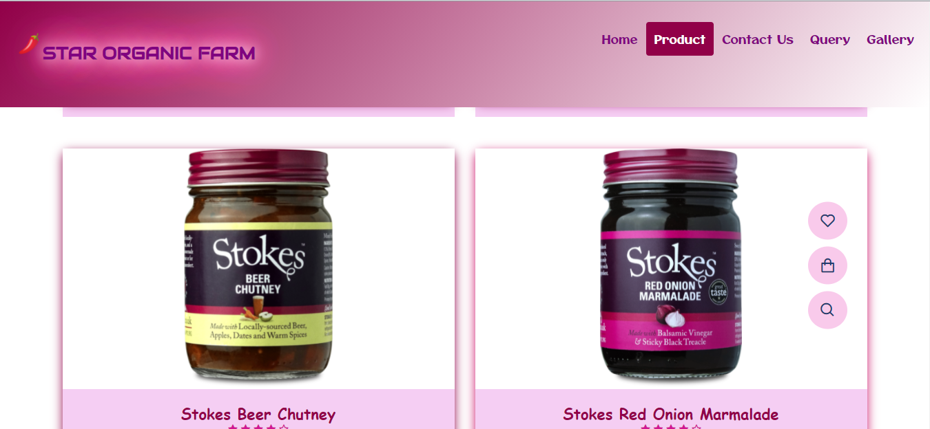
Some Snap shot of our Product page:
Project Name:
Star Organic Farm

Slide 19
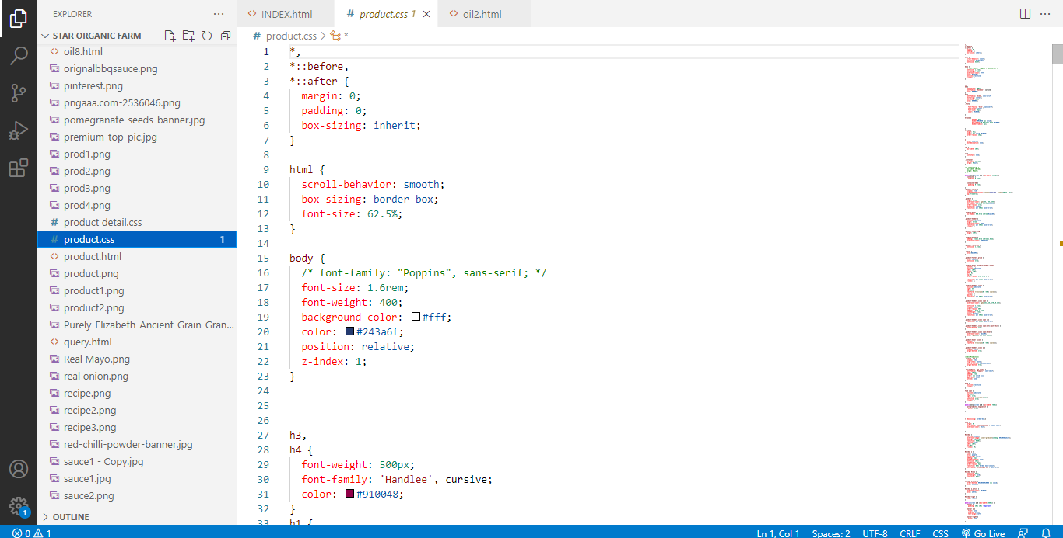
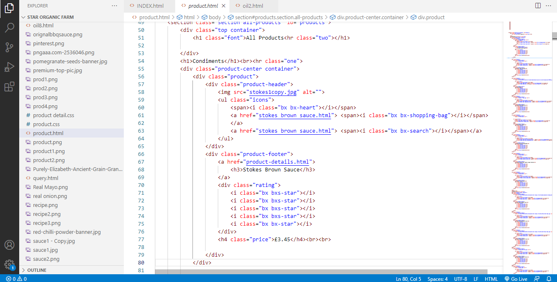
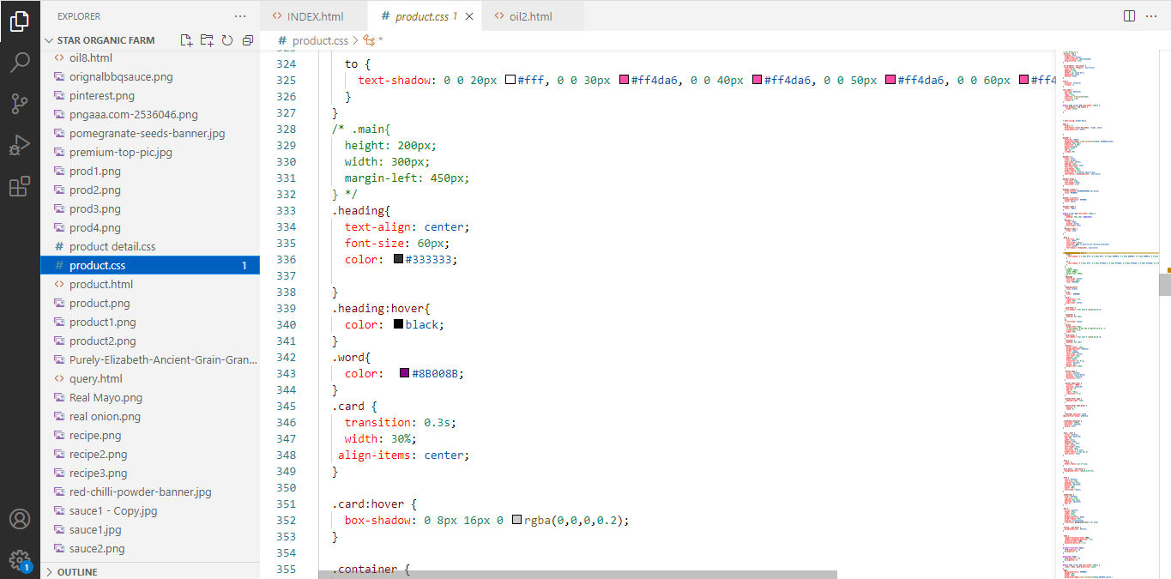
Some snap shots of Product page code:
Project Name:
Star Organic Farm

Slide 20
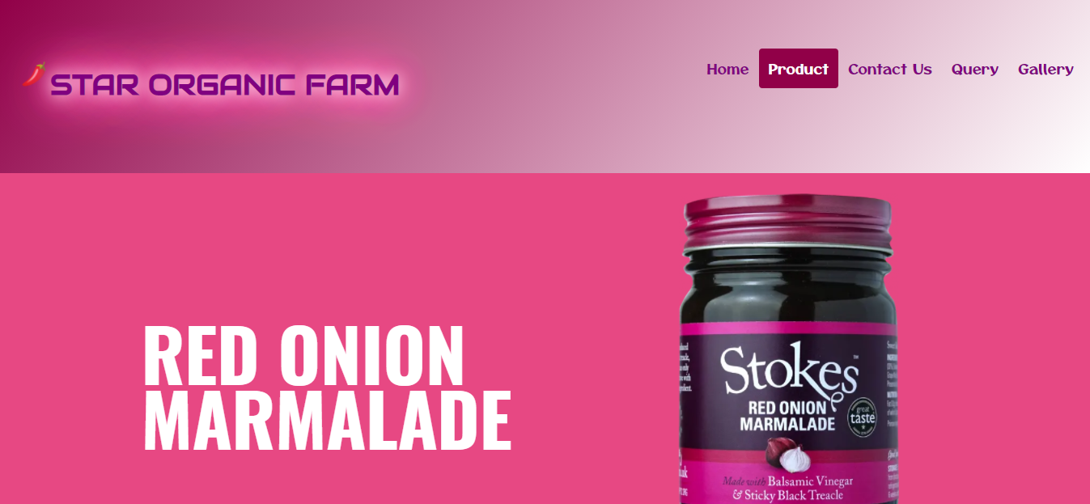

Snap shot of our Product Detail Pages:
Project Name:
Star Organic Farm

Slide 21
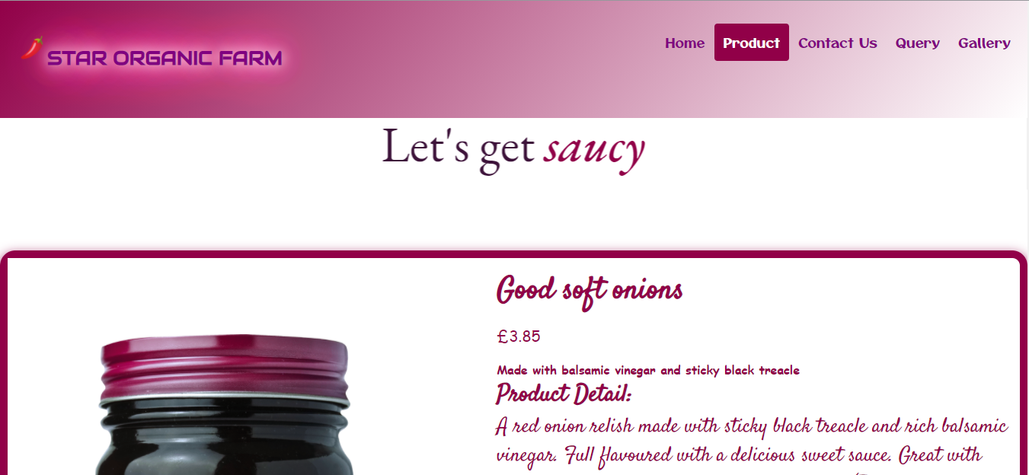
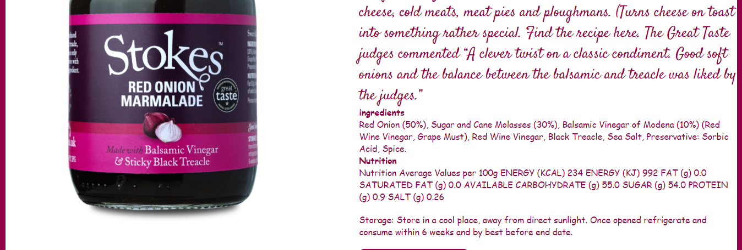
Snap shot of our Product Detail Pages:
Project Name:
Star Organic Farm

Slide 22
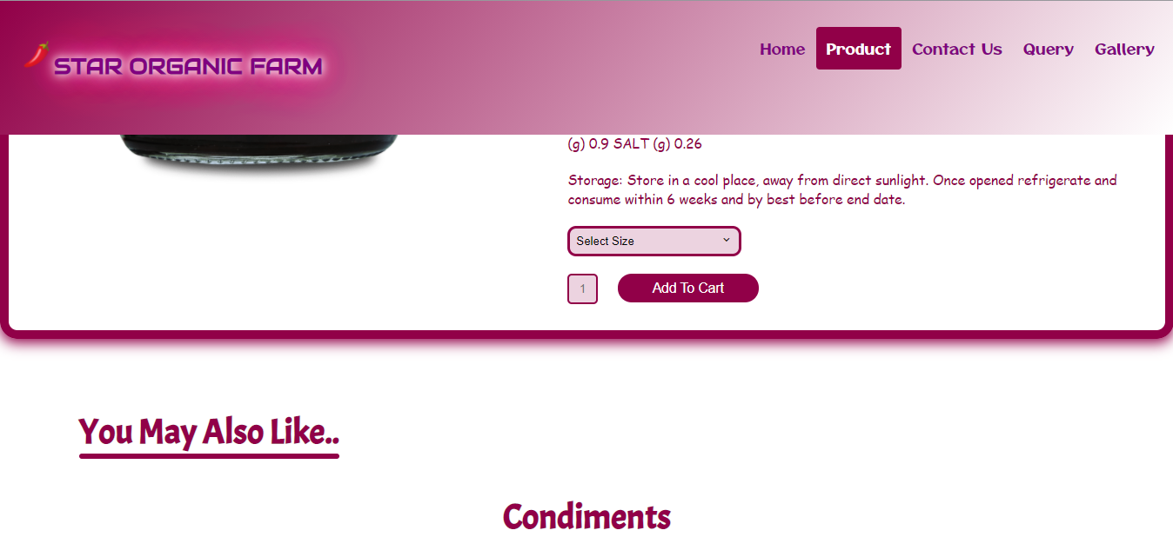
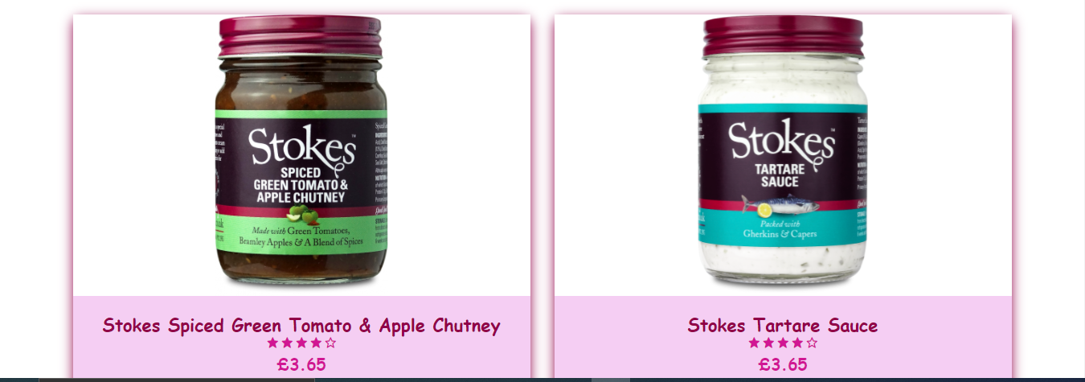
Snap shot of our Product Detail Pages:
Project Name:
Star Organic Farm

Slide 23
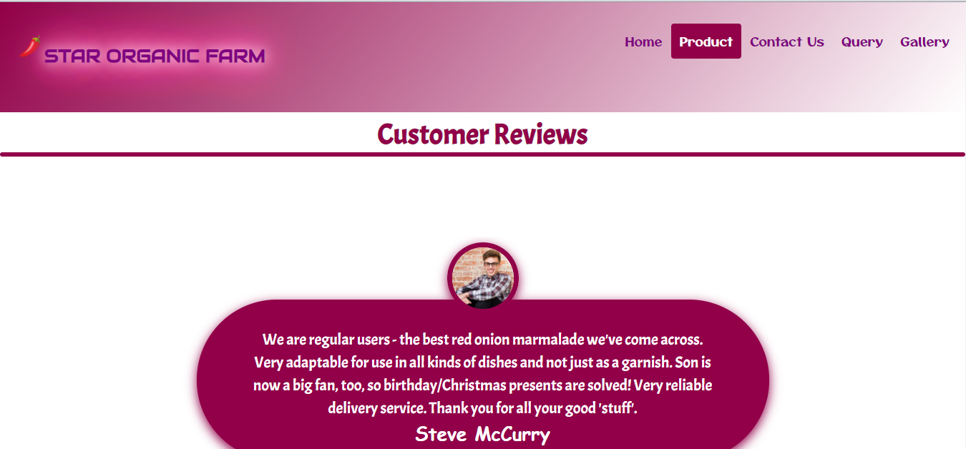
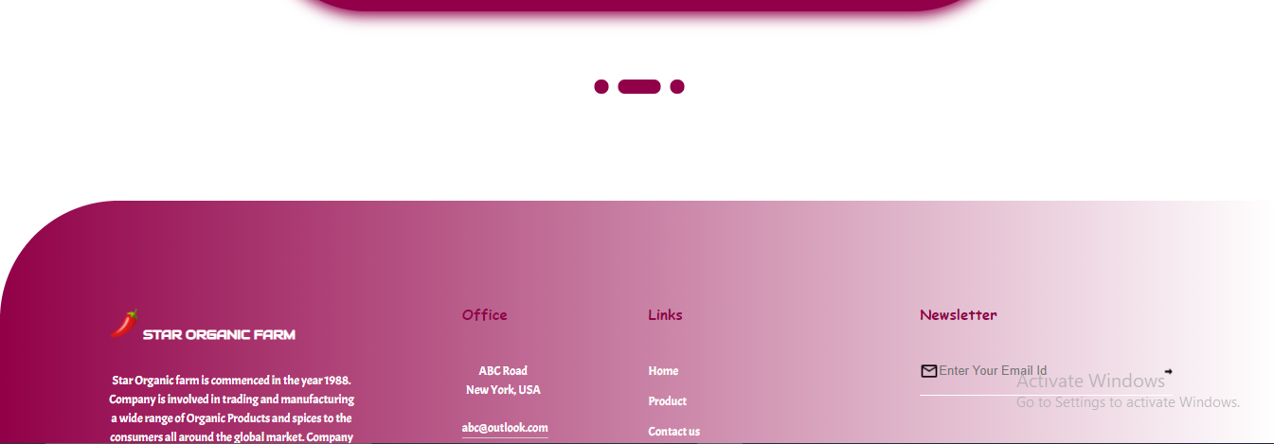
Snap shot of our Product Detail Pages:
Project Name:
Star Organic Farm

Slide 24
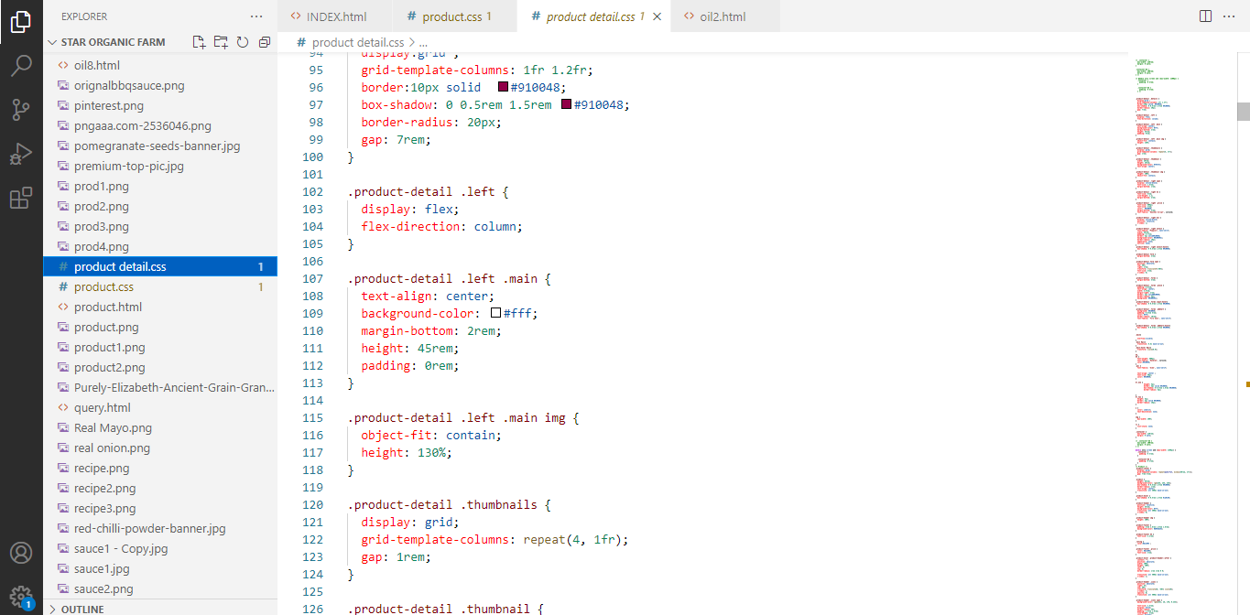
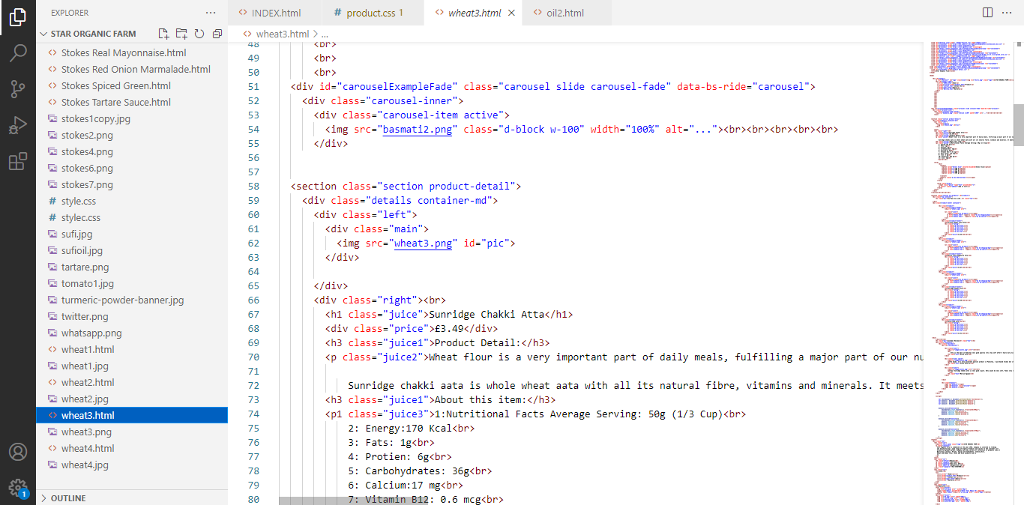
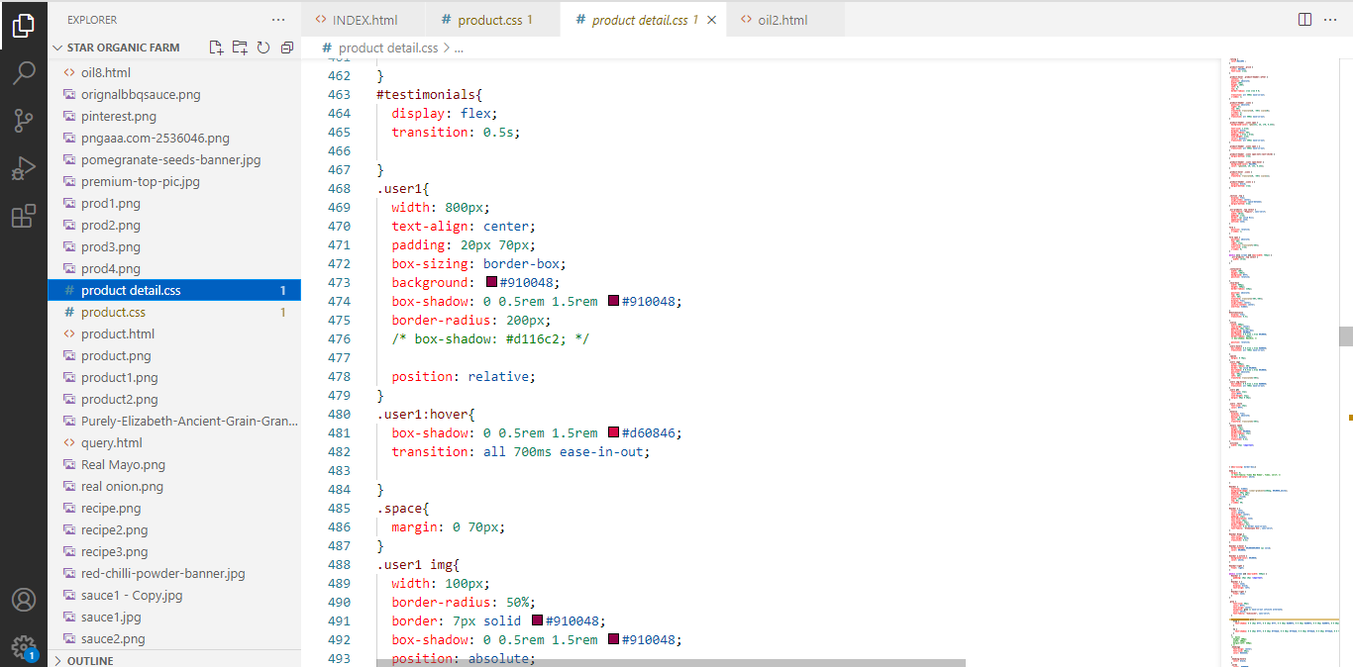
Some snap shots of Product detail pages code:
Project Name:
Star Organic Farm

Slide 25
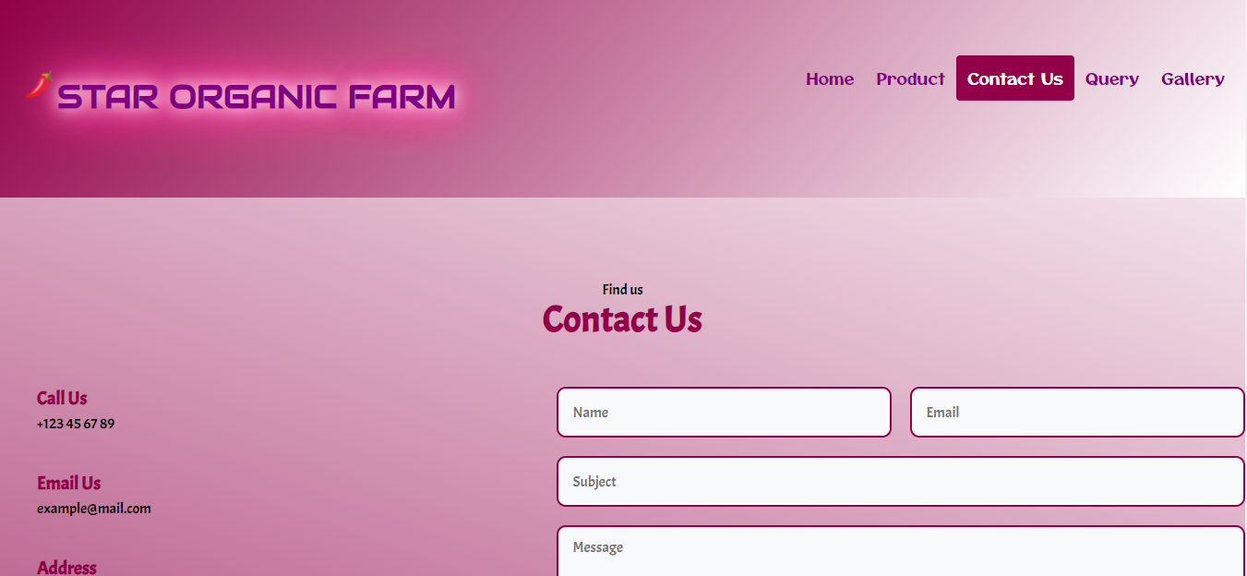

Snap shot of our Contact us:
Project Name:
Star Organic Farm

Slide 26
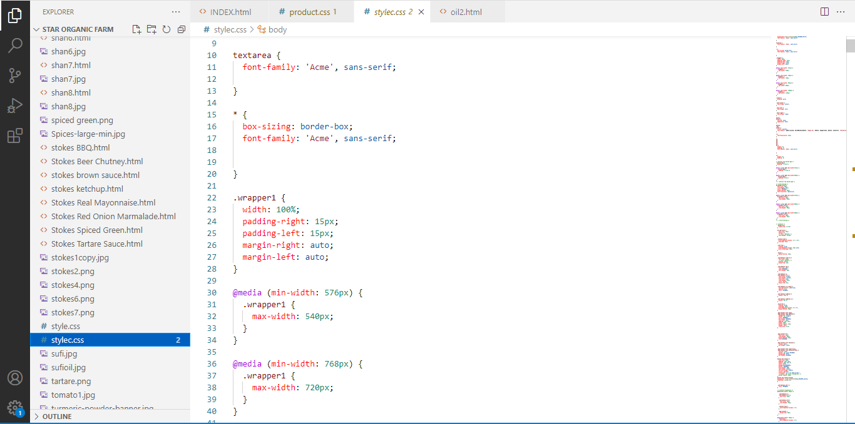
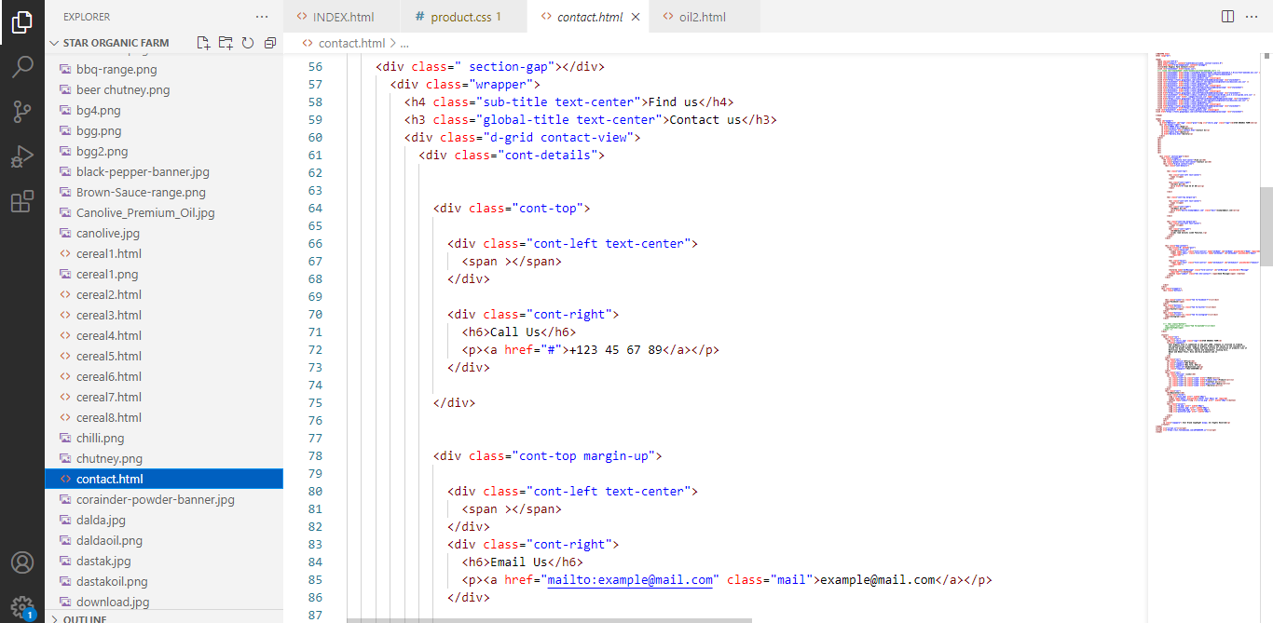
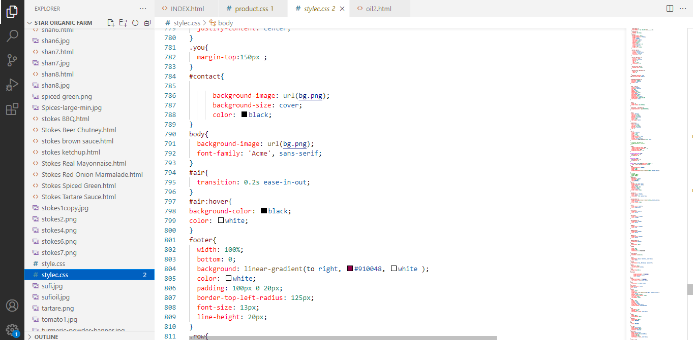
Some snap shots of Contact page code:
Project Name:
Star Organic Farm

Slide 27

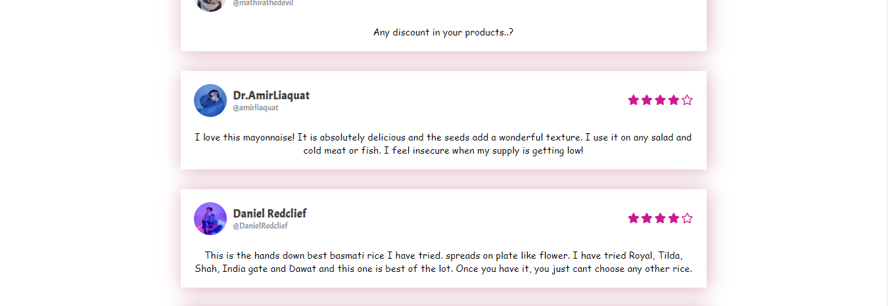
Snap shot of our Query:
Project Name:
Star Organic Farm

Slide 28
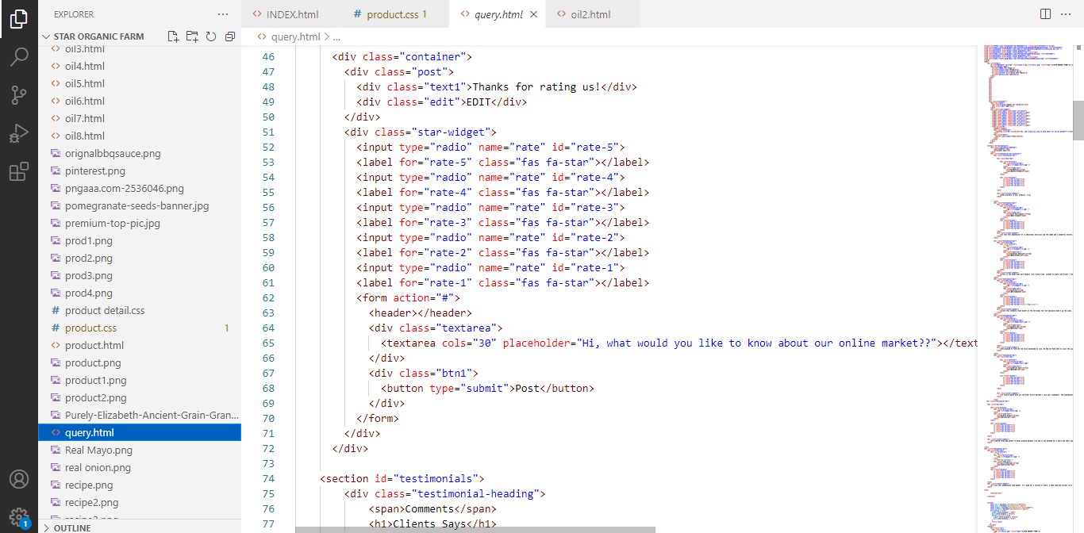
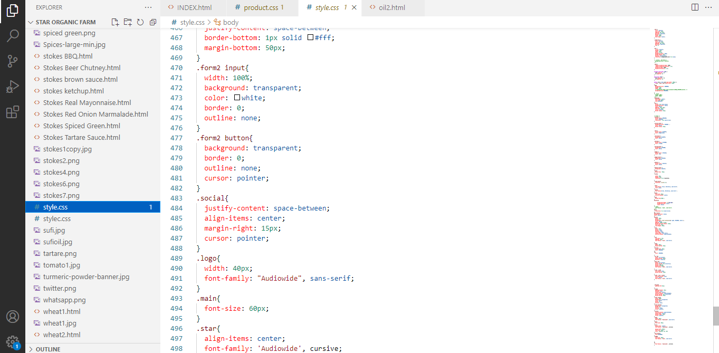
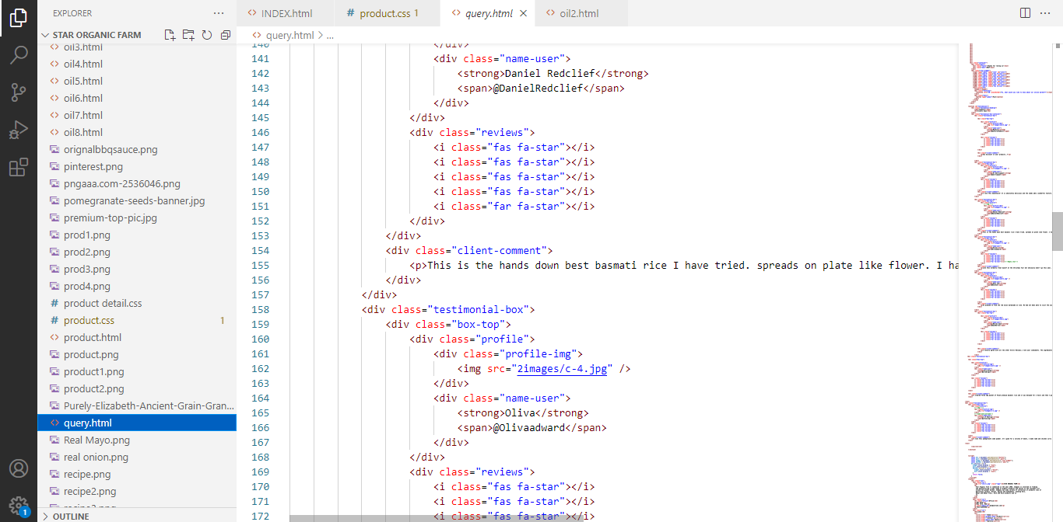
Some snap shots of Query page code:
Project Name:
Star Organic Farm

Slide 29
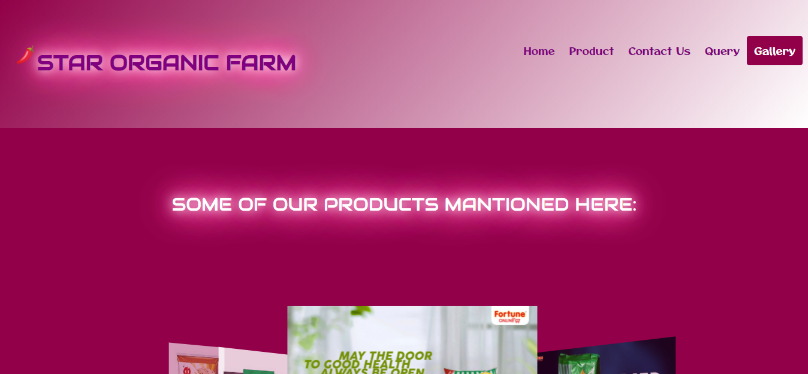

Snap shot of our Gallery:
Project Name:
Star Organic Farm

Slide 30
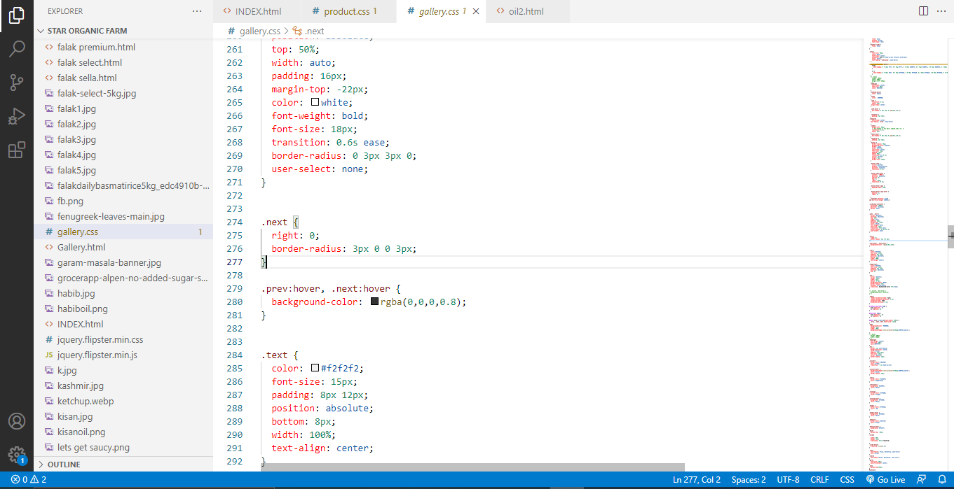
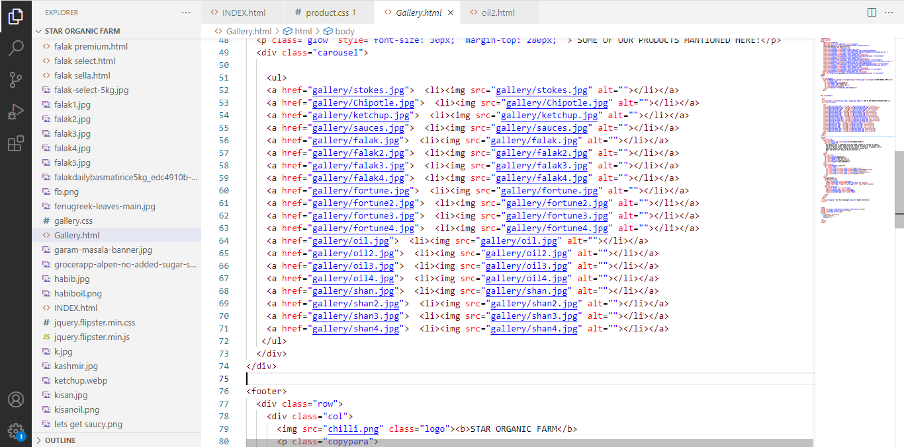
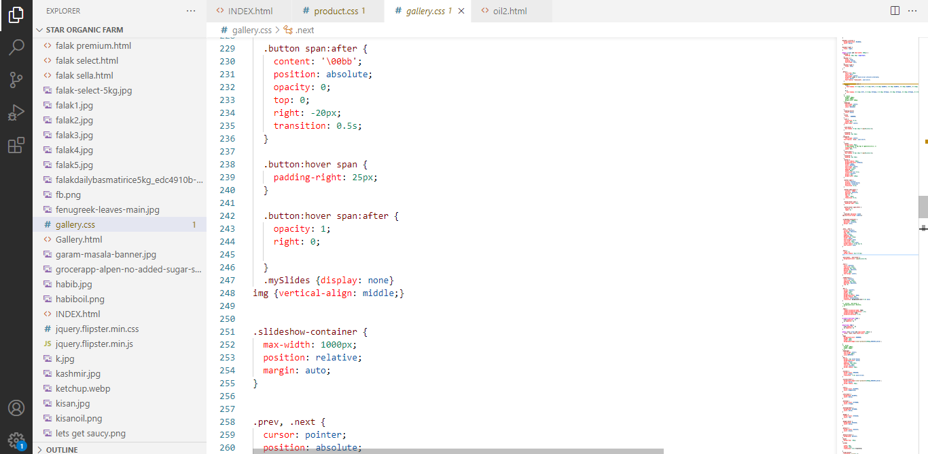
Some snap shots of Gallery page code:
Project Name:
Star Organic Farm

Slide 31
We hope u like our website
Thankyou from
Syed Shahryar Haider Rizvi
Gulfam Gujjar

